Slide 1
How to make Media

Slide 2
Types of Media
Culture Media
Minimal Media
Selective Media
Differential Media
Transport Media
Liquid v.s. Agar

Slide 3
Calculations
Need to make 1% w/v LB Agar
How Many Plates?
Each Volume of the Plates? 30mL-40mL Per Plate
Total Volume?

Slide 4
Where to find agar?
http://www.the-odin.com/lb-agar/

Slide 5
Antibiotic Selection
Kanamycin 30 mg/mL (51.50mM)
Streptomycin 33 mg/mL (45.29mM)

Slide 6
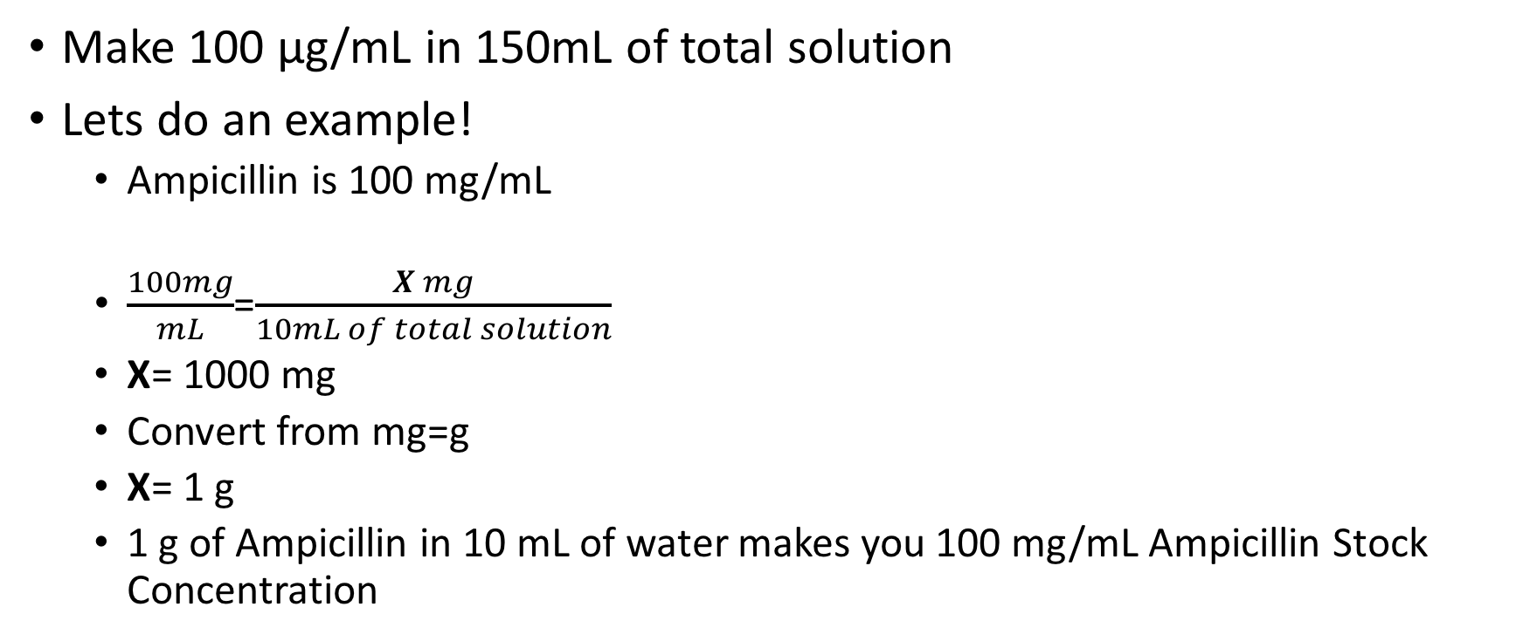
Antibiotic Stock Solution
Make 100 µg/mL in 150mL of total solution
Lets do an example!
Ampicillin is 100 mg/mL
$\frac{100mg}{mL}$=$\frac{X mg}{10mL of total solution}$
X= 1000 mg
Convert from mg=g
X= 1 g
1 g of Ampicillin in 10 mL of water makes you 100 mg/mL Ampicillin Stock Concentration

Slide 7
How to make Antibiotic Selective Media
Now DILUTE to make 100 µg/mL
M₁V₁=M₂V₂
For V₁ we will plug in our TOTAL volume of agar solution= 150mL
100 mg · 150mL = 100 µg · V₂
First convert 100mg to µg (1 µg = 0.001 mg)
100 mg= 100000 µg
100000 µg · 150mL = 100 µg · V₂
V₂= 0.15mL
Convert mL → µL (1mL= 1000 µL)

Slide 8
How to make Antibiotic Selective Media
You get 150 µL
Add 150 µL to your agar solution!
Now you have a 100 µg/mL in 150mL of total solution

Slide 9


Slide 10
Try it out with Kanamycin & Streptomycin

